Slide 1

Superheterodyne Receiver
Tanjina Akter
ID: 11809008
ICT 9th Batch

Slide 2
Feature
Simplicity of Operation
Good fidelity
Good Selectivity
Average Sensitivity
Adaptability to different types of aerials

Slide 3

WHY WE NEED IT?

Slide 4

WHY WE NEED IT?

Slide 5
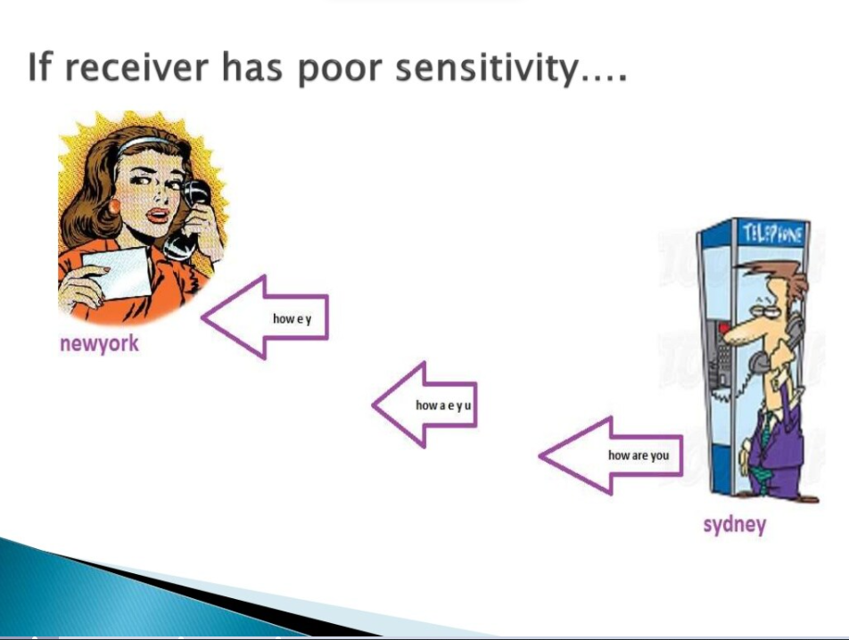
WHY WE NEED IT?

Slide 6
The Superheterodyne Receiver
Antenna
4. Image frequency rejection is done by IF filter
2. Determines the sensitivity of the receiver
aaaaaaa
Audio & Power Amplifiers
RF Stage
f₀
Mixer
f₀ -f_{a}
IF Amplifier
Detector
AGC
3. RF are converted into intermediate frequency fL0 = fRF – fIF
Local Osciliator
1. Select the desire frequency by tuning

Slide 7
Tuning Process
Select an AM station
Tune the RF amplifier to lower end of AM band.
Local Oscillator frequency set 1095 kHz
Mix the 1095 kHz and 640 kHz

Slide 8
Detector Section
It contains automatic gain control which is required to overcome atmospheric conditions that adversely affect signal strength between transmitters and receivers.
Rectifies the modulating signal by filtering out 455 kHz

Slide 9
Thank You

